Slide 1
Reducibility

Slide 2


Problem is reduced to problem
If we can solve problem then
we can solve problem

Slide 3
Problem is reduced to problem
If is decidable then is decidable
If is undecidable then is undecidable

Slide 4
Example:
the halting problem
is reduced to
the state-entry problem

Slide 5



The state-entry problem
Inputs:
Turing Machine
State
String
Question:
Does
enter state
on input ?

Slide 6
Theorem:
The state-entry problem is undecidable
Proof:
Reduce the halting problem to
the state-entry problem

Slide 7
Suppose we have an algorithm (Turing Machine)
that solves the state-entry problem
We will construct an algorithm
that solves the halting problem

Slide 8

Assume we have the state-entry algorithm:
YES
enters
Algorithm for
state-entry
problem
NO
doesn’t
enter

Slide 9
We want to design the halting algorithm:
YES
halts on
Algorithm for
Halting problem
NO
doesn’t
halt on

Slide 10


Modify input machine :
Add new state
From any halting state add transitions to
Single
halt state
halting states

Slide 11
halts
if and only if
halts on state

Slide 12

Algorithm for halting problem:
Inputs:
machine and string
1. Construct machine with state
2. Run algorithm for state-entry problem
with inputs:
,
,

Slide 13


Halting problem algorithm
YES
YES
Generate
State-entry
algorithm
NO
NO

Slide 14
We reduced the halting problem
to the state-entry problem
Since the halting problem is undecidable,
it must be that the state-entry problem
is also undecidable
END OF PROOF

Slide 15
Another example:
the halting problem
is reduced to
the blank-tape halting problem

Slide 16
The blank-tape halting problem
Input:
Turing Machine
Question:
Does
halt when started with
a blank tape?

Slide 17
Theorem:
The blank-tape halting problem is undecidable
Proof:
Reduce the halting problem to the
blank-tape halting problem

Slide 18
Suppose we have an algorithm
for the blank-tape halting problem
We will construct an algorithm
for the halting problem

Slide 19
Assume we have the
blank-tape halting algorithm:
halts on
blanks tape
YES
Algorithm for
blank-tape
halting problem
NO
doesn’t halt
on blank tape

Slide 20
We want to design the halting algorithm:
YES
halts on
Algorithm for
halting problem
NO
doesn’t
halt on

Slide 21
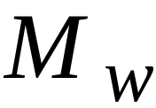
Construct a new machine
On blank tape writes
Then continues execution like
step 1
step2
if blank tape
execute
then write
with input

Slide 22
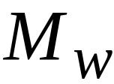
halts on input string
if and only if
halts when started with blank tape

Slide 23
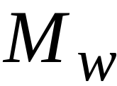
Algorithm for halting problem:
Inputs:
machine and string
1. Construct
2. Run algorithm for
blank-tape halting problem
with input
,
,

Slide 24
Halting problem algorithm
YES
blank-tape
halting
algorithm
YES
Generate
NO
NO

Slide 25
We reduced the halting problem
to the blank-tape halting problem
Since the halting problem is undecidable,
the blank-tape halting problem is
also undecidable
END OF PROOF

Slide 26

Summary of Undecidable Problems
Halting Problem:
Does machine halt on input ?
Membership problem:
Does machine accept string ?
In other words:
Is a string member of a
recursively enumerable language ?

Slide 27
Blank-tape halting problem:
Does machine halt when starting
on blank tape?
State-entry Problem:
Does machine enter state
on input ?

Slide 28
Uncomputable Functions

Slide 29

Uncomputable Functions
Values
region
Domain
A function is uncomputable if it cannot
be computed for all of its domain

Slide 30
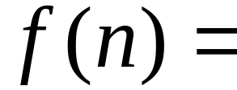

An uncomputable function:
maximum number of moves until
any Turing machine with states
halts when started with the blank tape

Slide 31
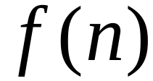
Theorem:
Function is uncomputable
Proof:
Assume for contradiction that
is computable
Then the blank-tape halting problem
is decidable

Slide 32

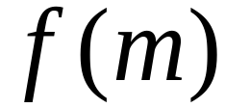
Algorithm for blank-tape halting problem:
Input: machine
1. Count states of :
2. Compute
3. Simulate for steps
starting with empty tape
If halts then return YES
otherwise return NO

Slide 33
Therefore, the blank-tape halting
problem is decidable
However, the blank-tape halting
problem is undecidable
Contradiction!!!

Slide 34
Therefore, function in uncomputable
END OF PROOF

Slide 35
Rice’s Theorem

Slide 36
Definition:
Non-trivial properties of
recursively enumerable languages:
any property possessed by some (not all)
recursively enumerable languages

Slide 37

Some non-trivial properties of
recursively enumerable languages:
is empty
is finite
contains two different strings
of the same length

Slide 38
Rice’s Theorem:
Any non-trivial property of
a recursively enumerable language
is undecidable

Slide 39
We will prove some non-trivial properties
without using Rice’s theorem

Slide 40

Theorem:
For any recursively enumerable language
it is undecidable to determine whether
is empty
Proof:
We will reduce the membership problem
to this problem

Slide 41
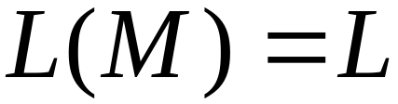
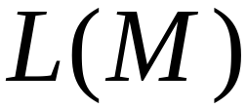
Let be the machine that accepts
Assume we have the empty language algorithm:
YES
empty
Algorithm for
empty language
problem
NO
not empty

Slide 42
We will design the membership algorithm:
YES
accepts
Algorithm for
membership
problem
NO
rejects

Slide 43
First construct machine :
When enters a final state,
compare original input string with
Accept if original input is
the same with

Slide 44

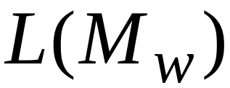

if and only if
is not empty

Slide 45
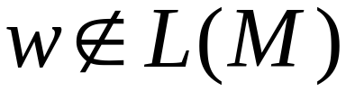
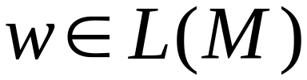
Algorithm for membership problem:
Inputs: machine and string
1. Construct
2. Determine if is empty
YES: then
NO: then

Slide 46
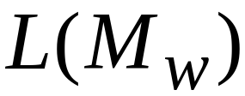
Membership algorithm
NO
Check if
YES
construct
YES
is empty
NO
END OF PROOF

